Slide 1
Retail Store Database
Presented by: Mariam Khomizuri
Professor: Paul Dantzing
Date: May 02, 2026

Slide 2
This database represents real business data from my mother’s retail store in Georgia.
Includes 10 tables: Country, Store, Employee, Customer, Product, Size, Product Size, Sales Transaction, Sales Detail, Payment
Built using real store data, ensuring realistic analysis
Contains a total of 625 rows across all tables
Table Distribution:
Country (3), Store (2), Employee (4), Customer (10),
Product (107), Size (26), Product Size (233),
Sales Transaction (80), Sales Detail (80), Payment (80)

Slide 3
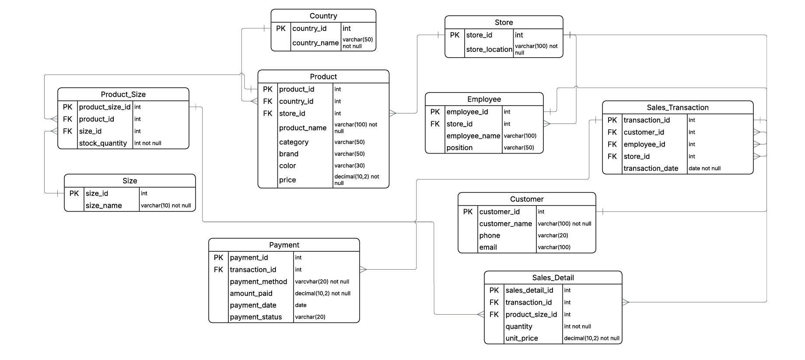
UML Entity Relationship Diagram

Slide 4
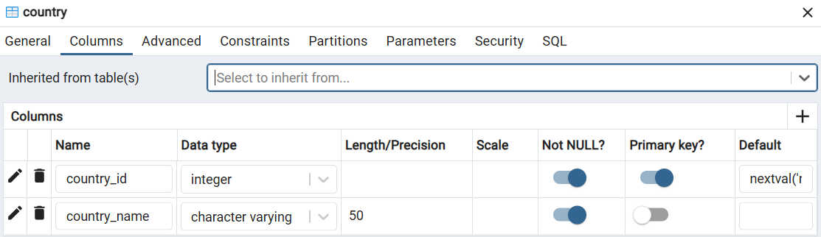
Create Table Country
CREATE TABLE Country (
country_id INT PRIMARY KEY,
country_name VARCHAR(50) NOT NULL
);

Slide 5
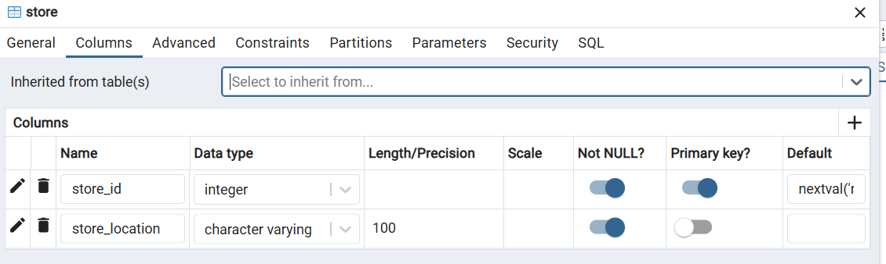
Create Table Store
CREATE TABLE Store (
store_id INT PRIMARY KEY,
store_location VARCHAR(100) NOT NULL
);

Slide 6
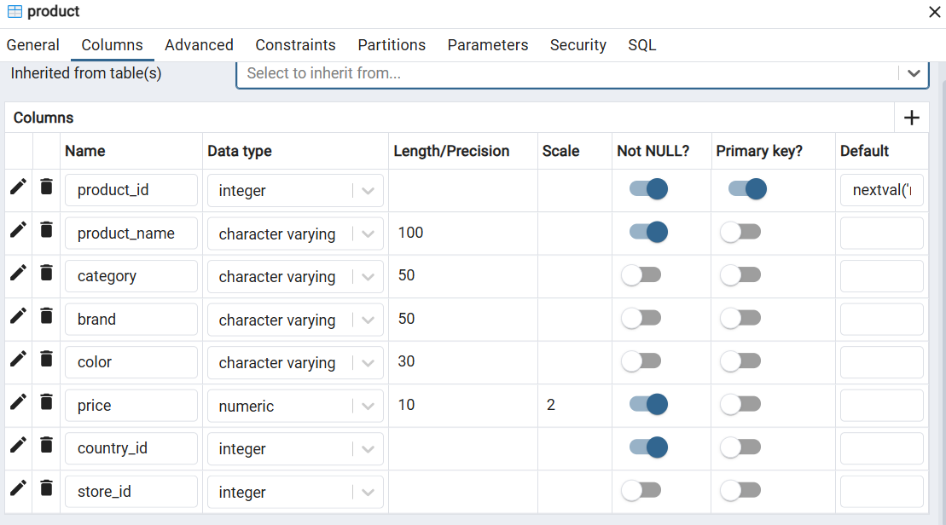
Create Table Product
CREATE TABLE Product (
product_id INT PRIMARY KEY,
country_id INT,
store_id INT NOT NULL,
product_name VARCHAR(100) NOT NULL,
category VARCHAR(50),
brand VARCHAR(50),
color VARCHAR(30),
price DECIMAL(10,2) NOT NULL,
FOREIGN KEY (country_id) REFERENCES Country(country_id)
FOREIGN KEY (store_id) REFERENCES Store(store_id)
);

Slide 7
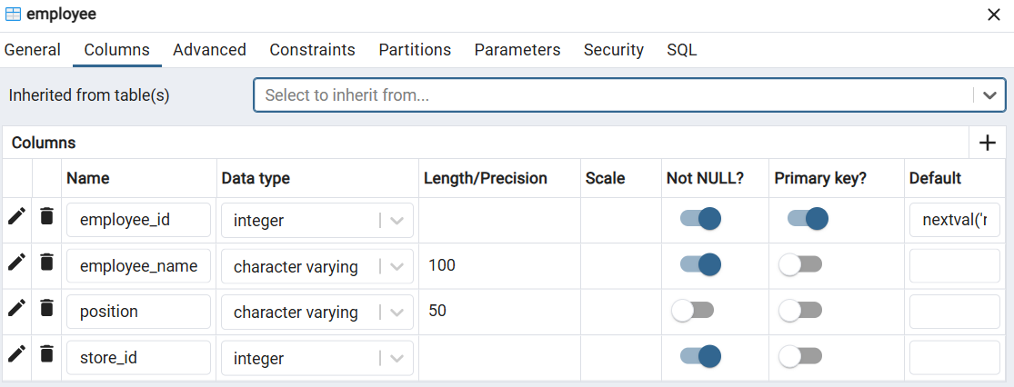
Create Table Employee
CREATE TABLE Employee (
employee_id INT PRIMARY KEY,
store_id INT,
employee_name VARCHAR(100),
position VARCHAR(50),
FOREIGN KEY (store_id) REFERENCES Store(store_id)
);

Slide 8
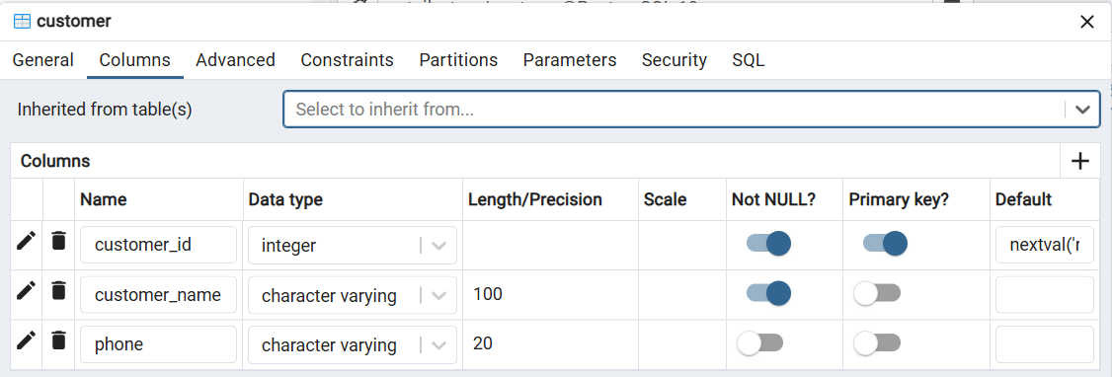
Create Table Customer
CREATE TABLE Customer (
customer_id INT PRIMARY KEY,
customer_name VARCHAR(100) NOT NULL,
phone VARCHAR(20),
);

Slide 9
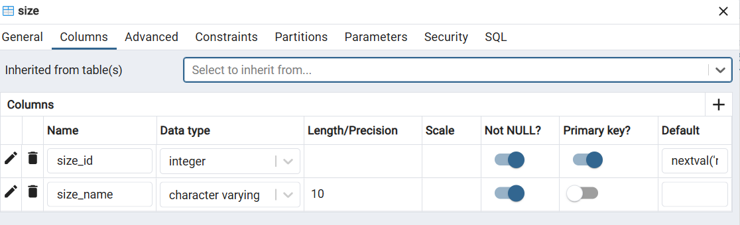
Create Table Size
CREATE TABLE Size (
size_id INT PRIMARY KEY,
size_name VARCHAR(10) NOT NULL
);

Slide 10
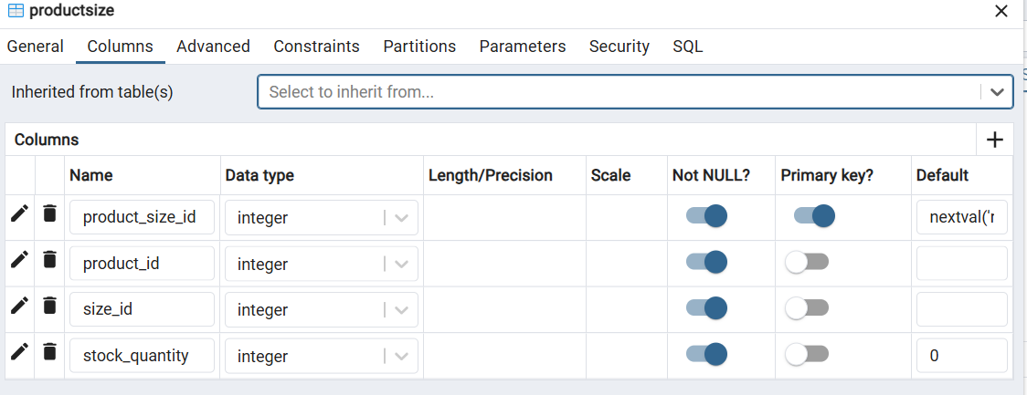
Create Table Product Size
CREATE TABLE Product_Size (
product_size_id INT PRIMARY KEY,
product_id INT,
size_id INT,
stock_quantity INT NOT NULL,
FOREIGN KEY (product_id) REFERENCES Product(product_id),
FOREIGN KEY (size_id) REFERENCES Size(size_id)
);

Slide 11
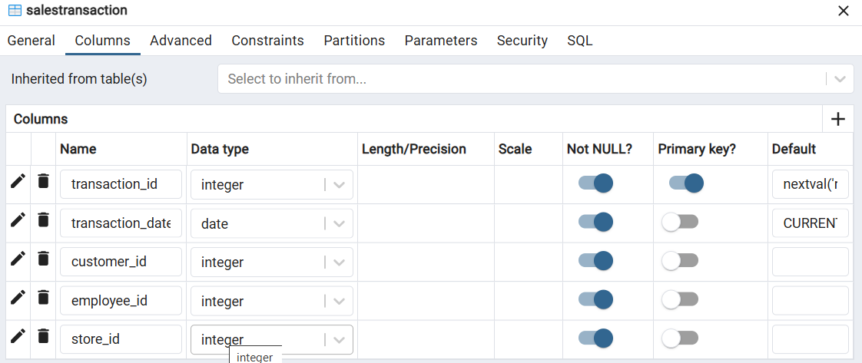
Create Table Sales Transaction
CREATE TABLE Sales_Transaction (
transaction_id INT PRIMARY KEY,
customer_id INT,
employee_id INT,
store_id INT,
transaction_date DATE NOT NULL,
FOREIGN KEY (customer_id) REFERENCES Customer(customer_id),
FOREIGN KEY (employee_id) REFERENCES Employee(employee_id),
FOREIGN KEY (store_id) REFERENCES Store(store_id)
);

Slide 12
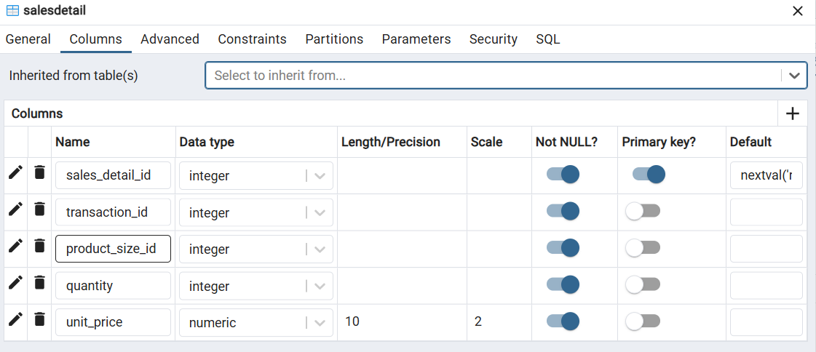
Create Table Sales Detail
CREATE TABLE Sales_Detail (
sales_detail_id INT PRIMARY KEY,
transaction_id INT,
product_size_id INT,
quantity INT NOT NULL,
unit_price DECIMAL(10,2) NOT NULL,
FOREIGN KEY (transaction_id) REFERENCES Sales_Transaction(transaction_id),
FOREIGN KEY (product_size_id) REFERENCES Product_Size(product_size_id)
);

Slide 13
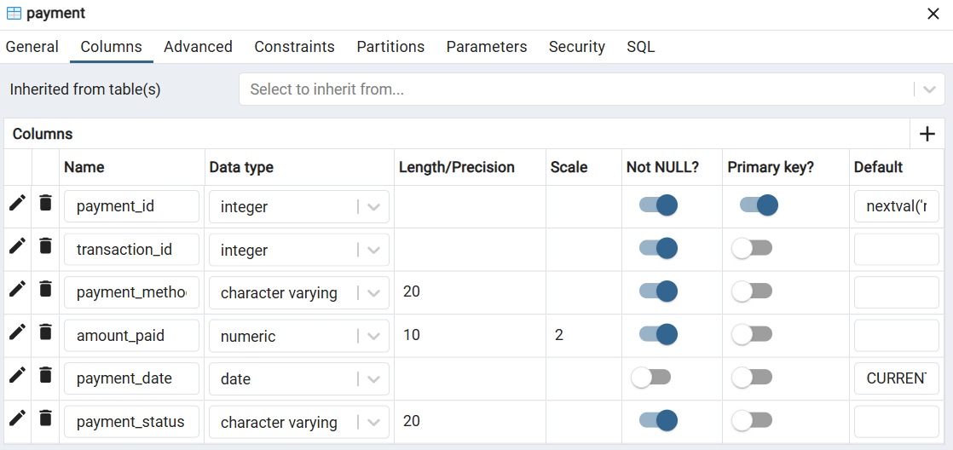
Create Table Payment
CREATE TABLE Payment (
payment_id INT PRIMARY KEY,
transaction_id INT,
payment_method VARCHAR(20) NOT NULL,
amount_paid DECIMAL(10,2) NOT NULL,
payment_date DATE,
payment_status VARCHAR(20),
FOREIGN KEY (transaction_id) REFERENCES Sales_Transaction(transaction_id)
);

Slide 14
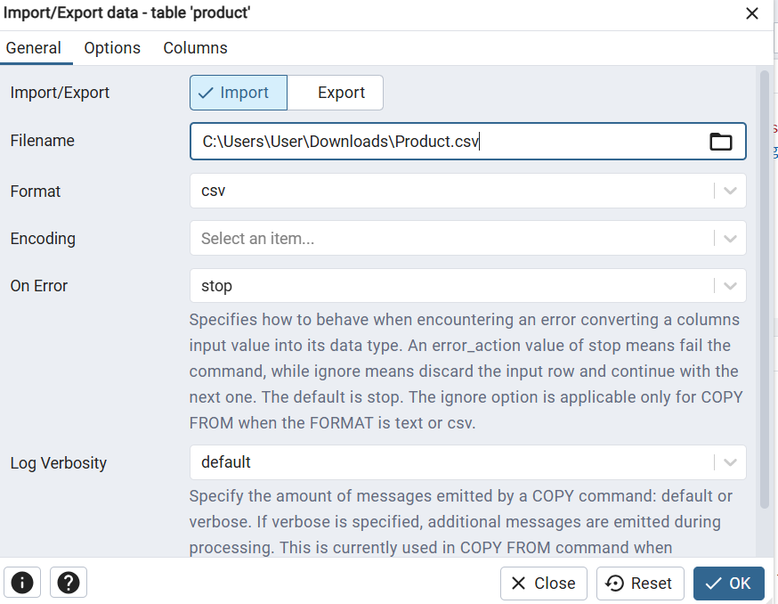
Data Preparation and Import
CSV File Import
Data was prepared in CSV files (one file per table)
Imported into the database using Import/Export data function
Manual Data Insertion
Additional data was inserted using SQL INSERT statements
Used to add missing or specific records
Example:
Product Table and Country Table
INSERT INTO Country (country_id, country_name)
VALUES
(1, 'Turkey'),
(2, 'Italy'),
(3, 'Georgia');

Slide 15
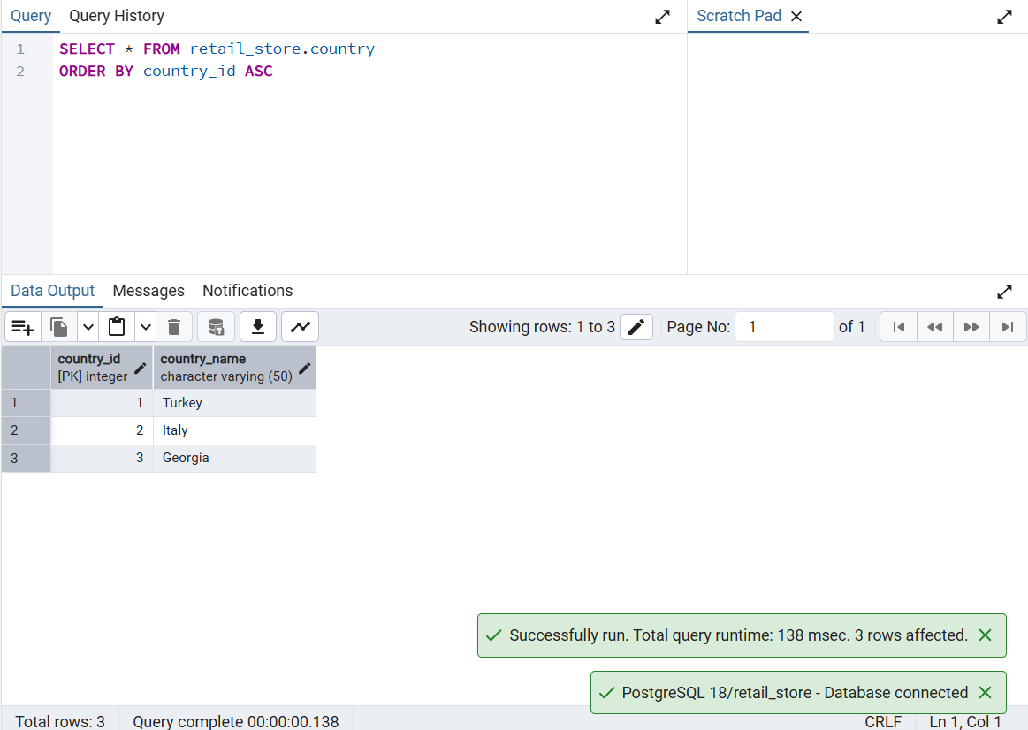
Country Table

Slide 16
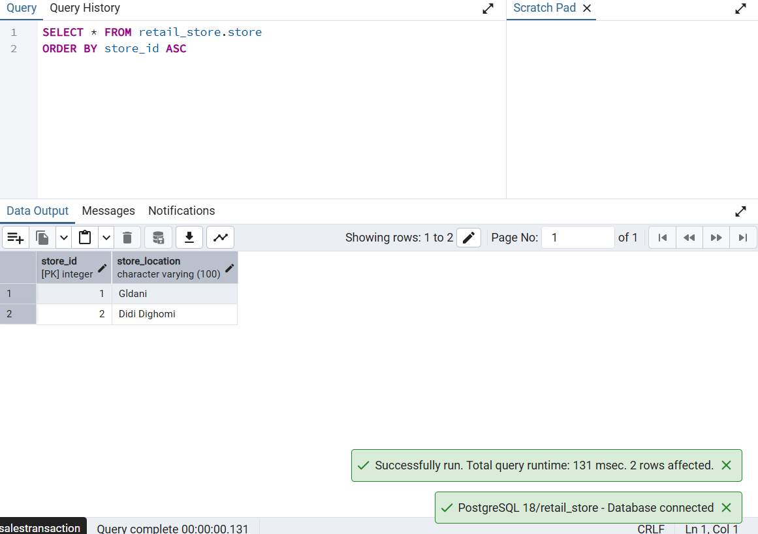
Store Table

Slide 17
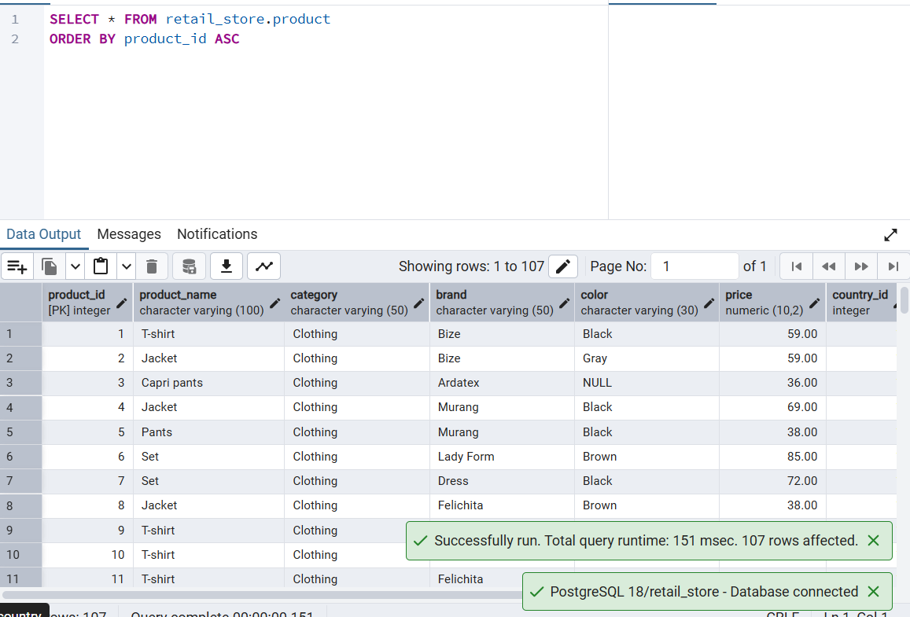
Product Table

Slide 18
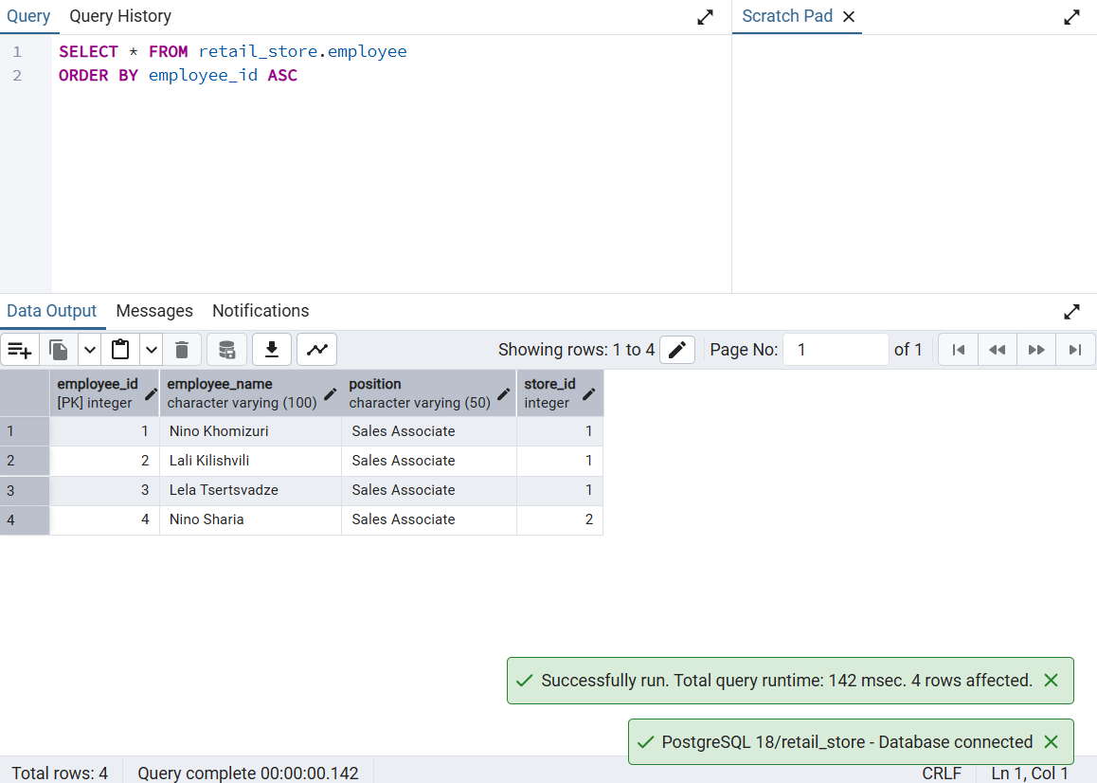
Employee Table

Slide 19
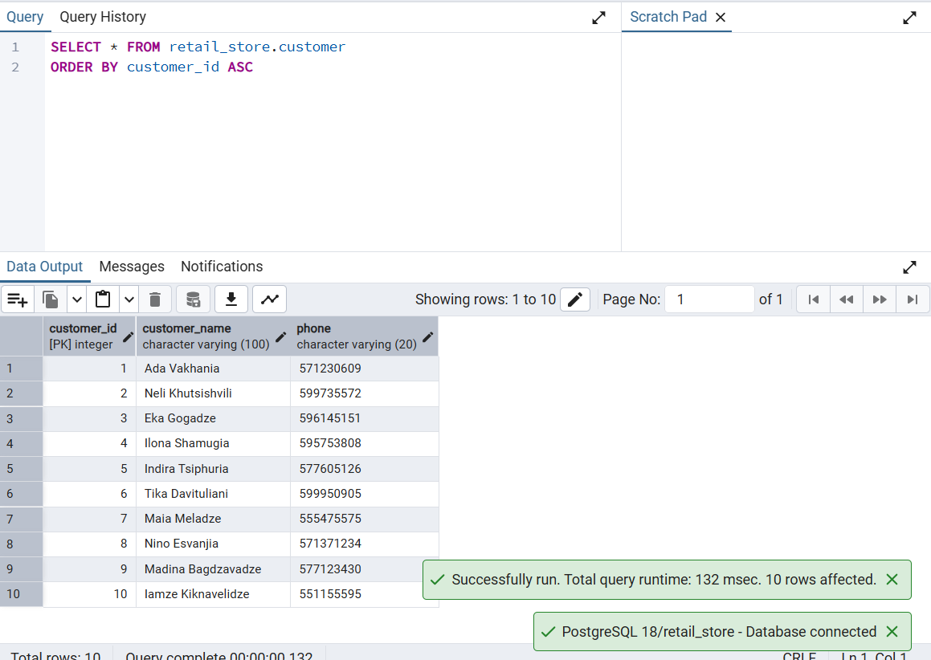
Customer Table

Slide 20
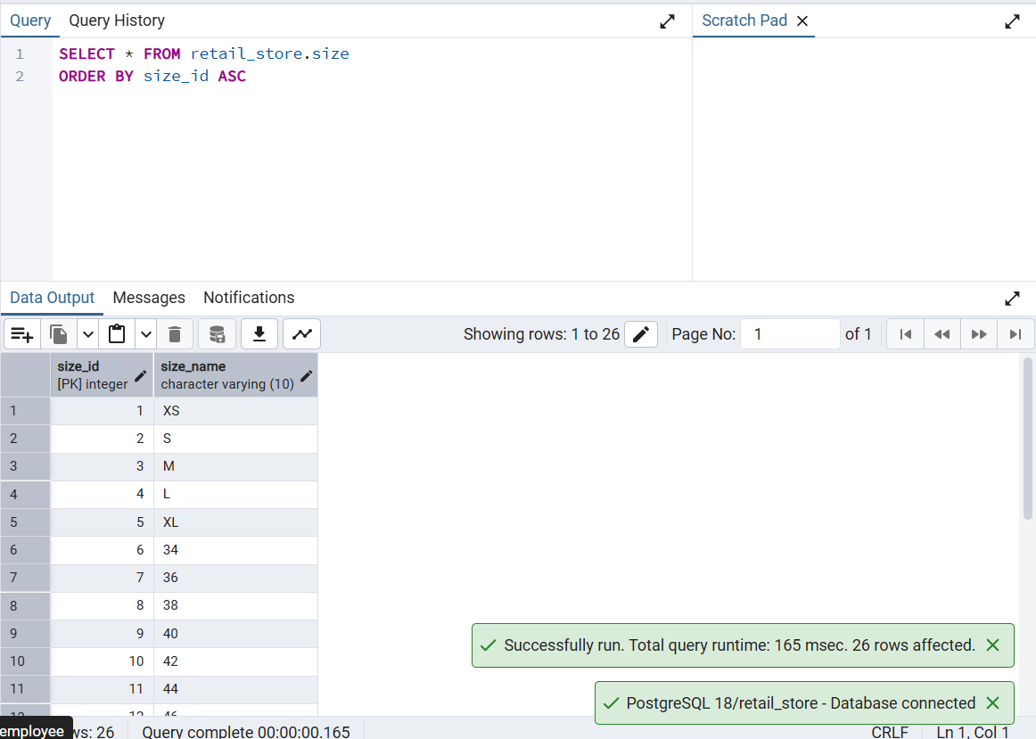
Size Table

Slide 21
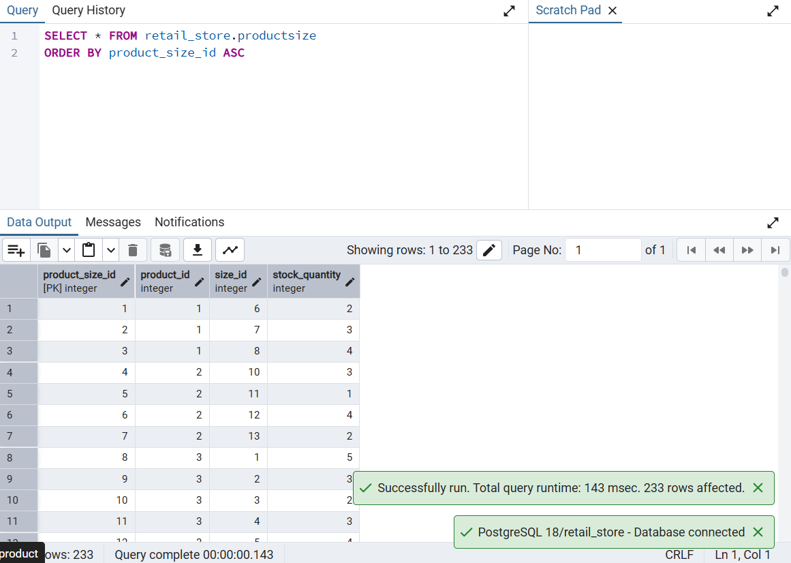
Product Size Table

Slide 22
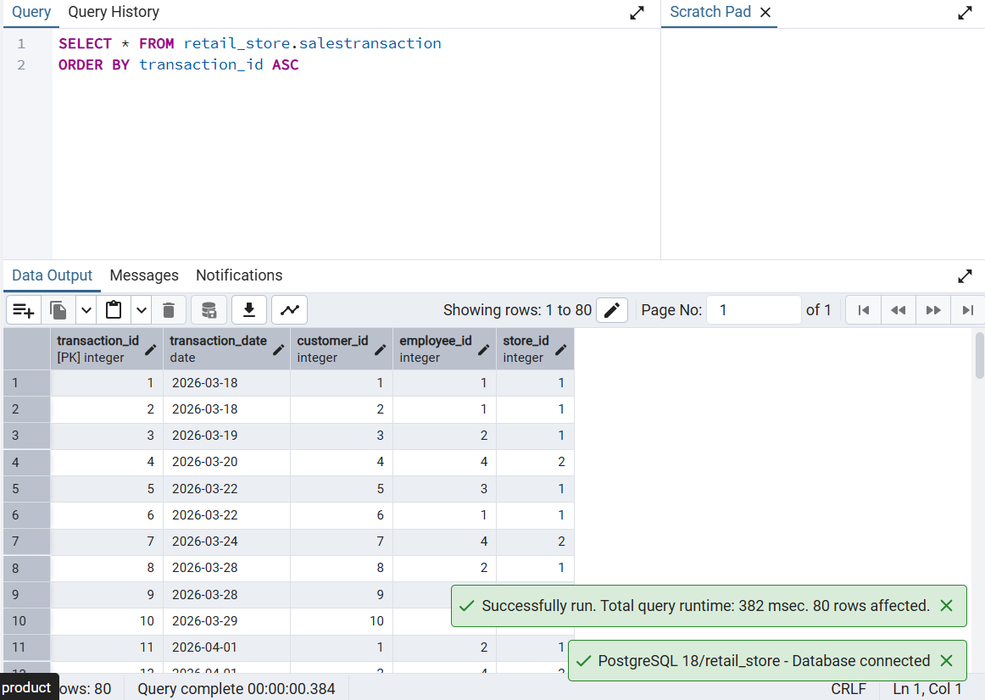
Sales Transaction Table

Slide 23
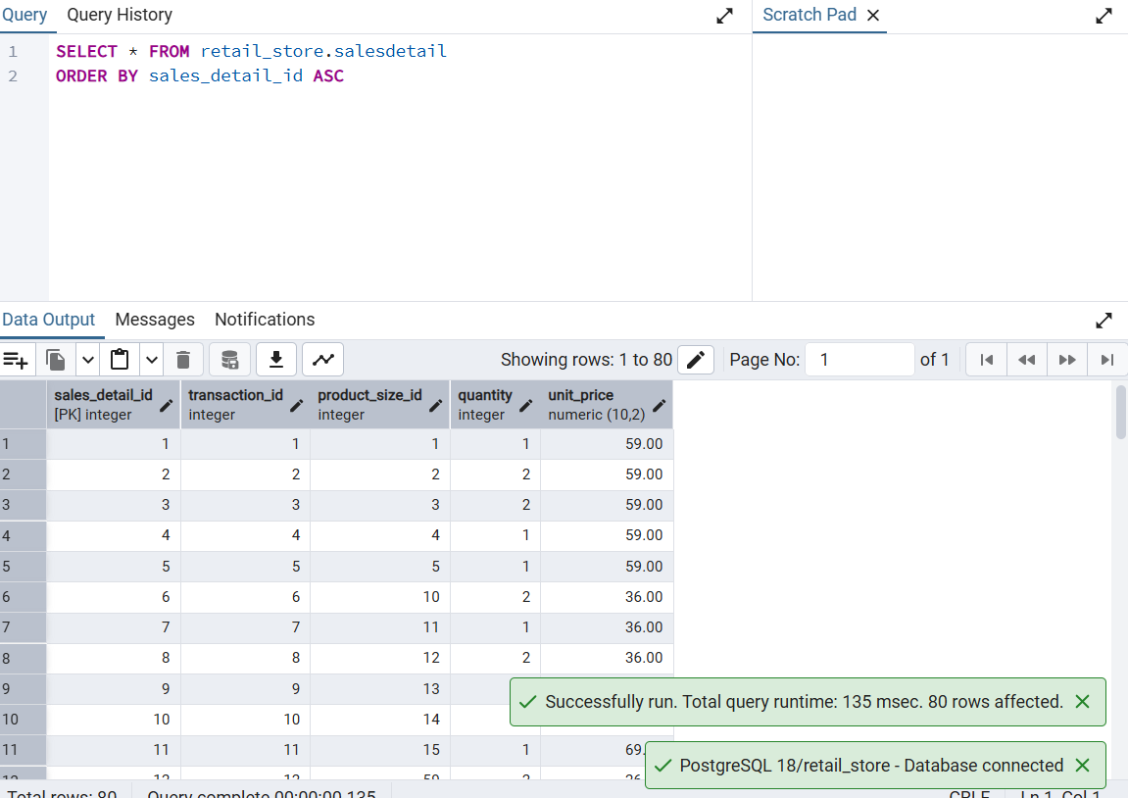
Sales Detail Table

Slide 24
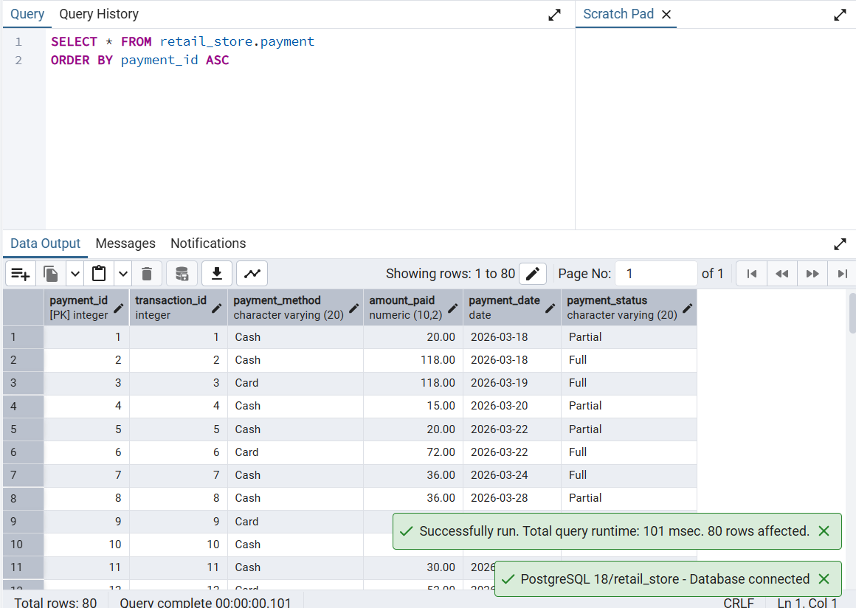
Payment Table

Slide 25
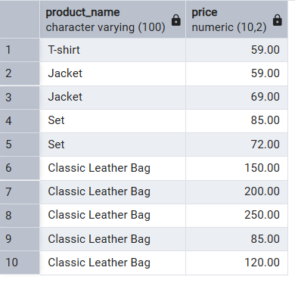
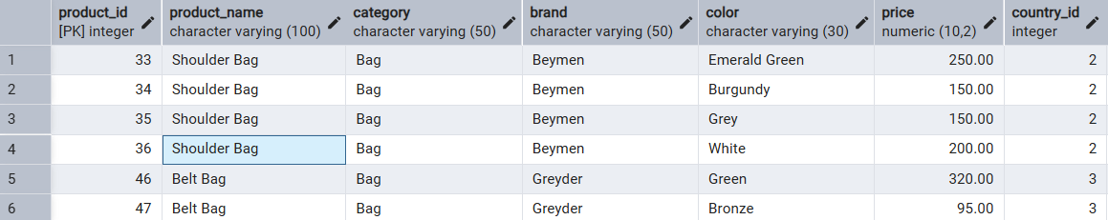
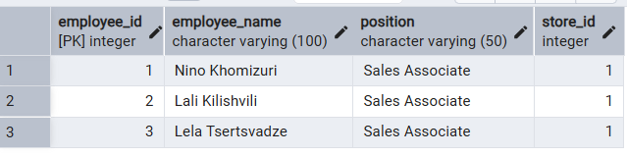
SQL Queries
Filtering (WHERE)
Products with price greater than 50 (limit 10)
SELECT product_name, price
FROM retail_store.product
WHERE price > 50 limit 10;
All bags which is in store 2
SELECT *
FROM retail_store.product
WHERE category = 'Bag' AND store_id = 2;
Employees working in store 1
SELECT *
FROM retail_store.employee
WHERE store_id = 1;

Slide 26
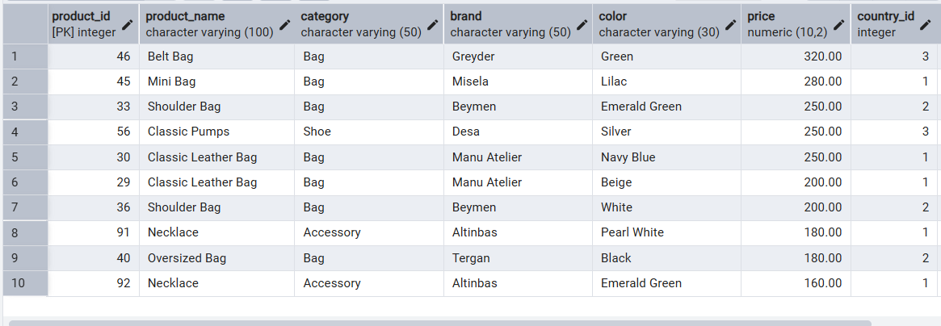
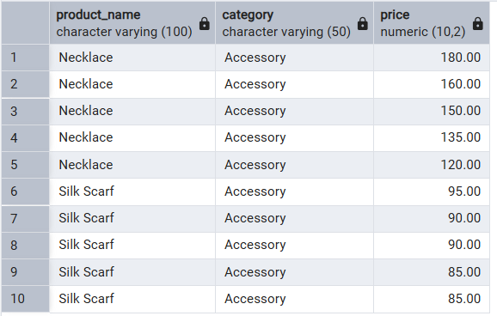
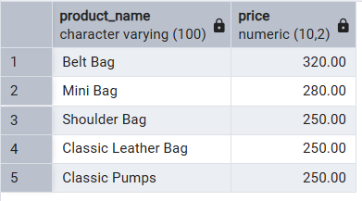
SQL Queries
Sorting (ORDER BY)
Products sorted by price (high to low limit 10)
SELECT * FROM retail_store.product
ORDER BY price DESC limit 10;
Products sort by category, then price (limit 10)
SELECT product_name, category, price
FROM retail_store.product
ORDER BY category ASC, price DESC;
Top 5 most expensive products
SELECT product_name, price
FROM Product
ORDER BY price DESC
LIMIT 5;

Slide 27
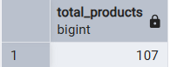
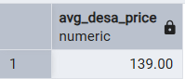
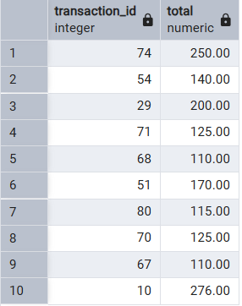
SQL Queries
Aggregate Functions
Total number of products
SELECT COUNT(*) As total_products
FROM retail_store.product;
Average price of “Desa” shoes
SELECT ROUND(AVG(price), 2) AS avg_desa_price
FROM retail_store.product
WHERE brand = 'Desa' AND category = 'Shoe'
Transactions with high sales
SELECT transaction_id, SUM(quantity * unit_price) AS total
FROM retail_store.salesdetail
GROUP BY transaction_id
HAVING SUM(quantity * unit_price) > 100 limit 10

Slide 28
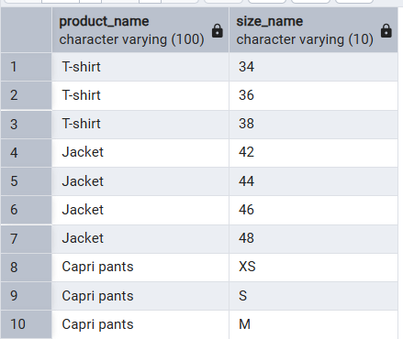
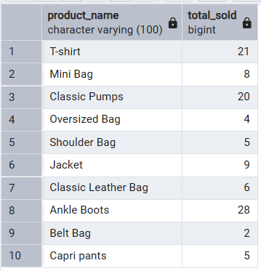
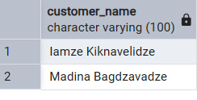
SQL Queries
Join Functions
All sizes available for each product (limit 10)
SELECT p.product_name, s.size_name
FROM retail_store.product p
JOIN retail_store.productsize ps ON p.product_id = ps.product_id
JOIN retail_store.size s ON ps.size_id = s.size_id limit 10;
Total quantity sold per product
SELECT p.product_name,SUM(sd.quantity) AS total_sold
FROM retail_store.product p
JOIN retail_store.productsize ps ON p.product_id = ps.product_id
JOIN retail_store.salesdetail sd ON ps.product_size_id = sd.product_size_id
GROUP BY p.product_name;
Customers who made purchases on April 10, 2026
SELECT DISTINCT c.customer_name
FROM retail_store.customer c
JOIN retail_store.salestransaction st
ON c.customer_id = st.customer_id
WHERE st.transaction_date = '2026-04-10';

Slide 29
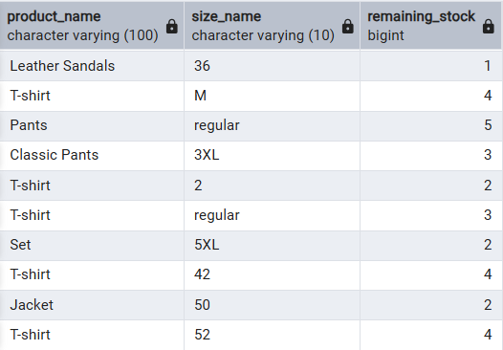
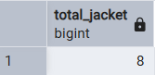
SQL Queries
Interesting Select
10 products with their size and remaining stock after sales
SELECT
p.product_name,
s.size_name,
ps.stock_quantity - COALESCE(SUM(sd.quantity), 0) AS remaining_stock
FROM retail_store.product p
JOIN retail_store.productsize ps ON p.product_id = ps.product_id
JOIN retail_store.size s ON ps.size_id = s.size_id
LEFT JOIN retail_store.salesdetail sd ON ps.product_size_id = sd.product_size_id
GROUP BY p.product_name, s.size_name, ps.stock_quantity limit 10;
Total number of jackets sold in March
SELECT SUM(sd.quantity) AS total_jacket
FROM retail_store.salesdetail sd
JOIN retail_store.productsize ps ON sd.product_size_id = ps.product_size_id
JOIN retail_store.product p ON ps.product_id = p.product_id
JOIN retail_store.salestransaction st ON sd.transaction_id = st.transaction_id
WHERE p.product_name LIKE '%Jacket%'
AND EXTRACT(MONTH FROM st.transaction_date) = 3;

Slide 30
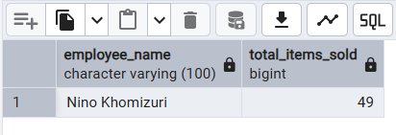
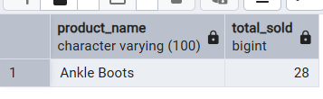
SQL Queries
Interesting Select
The Employee who sold the most items or made the most sales
SELECT
e.employee_name,
SUM(sd.quantity) AS total_items_sold
FROM retail_store.employee e
JOIN retail_store.salestransaction st
ON e.employee_id = st.employee_id
JOIN retail_store.salesdetail sd
ON st.transaction_id = sd.transaction_id
GROUP BY e.employee_name
ORDER BY total_items_sold DESC
LIMIT 1;
The Most popular product
SELECT
p.product_name,
SUM(sd.quantity) AS total_sold
FROM retail_store.product p
JOIN retail_store.productsize ps
ON p.product_id = ps.product_id
JOIN retail_store.salesdetail sd
ON ps.product_size_id = sd.product_size_id
GROUP BY p.product_name
ORDER BY total_sold DESC
LIMIT 1;

Slide 31
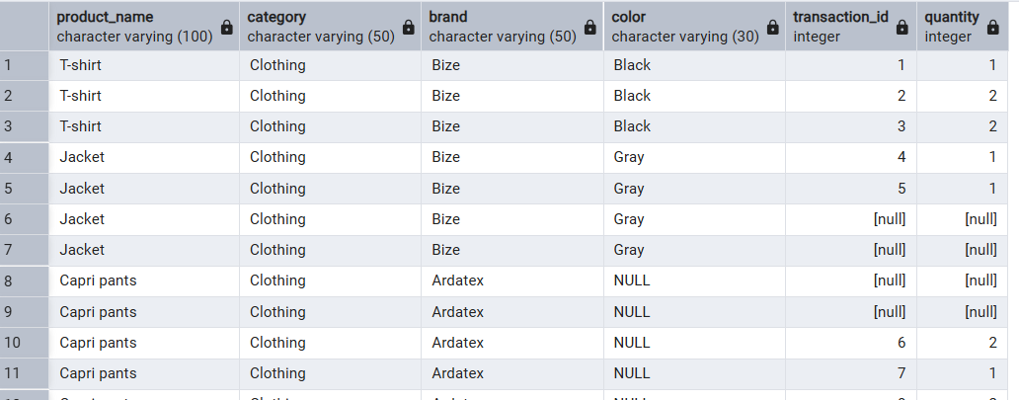
SQL Queries
Full Outer Join
All products and all sales records, including unmatched data from both sides
SELECT
p.product_name,
p.category,
p.brand,
p.color,
sd.transaction_id,
sd.quantity
FROM retail_store.product p
FULL OUTER JOIN retail_store.productsize ps
ON p.product_id = ps.product_id
FULL OUTER JOIN retail_store.salesdetail sd
ON ps.product_size_id = sd.product_size_id;

